Slide 1
4.3 - Logarithms 4.4 – Properties of Logarithms

Slide 2
4.3 Logarithms (Pg 355) Example
Suppose a colony of bacteria doubles in size everyday. If the colony starts
with 50 bacteria, how long will it be before there are 800 bacteria ?
Example P(x) = 50. 2^{x} ,when P(x) = 800
According to statement 800 = 50.2 ^{x}
Dividing both sides by 50 yields
16 = 2^{x}
What power must we raise 2 in order to get 16 ?
Because 2 ⁴ = 16
^{Log}₂ 16 = 4
In other words, we solve an exponential equation by computing a logarithm.
Check x = 4
P(4) = 50. 2^{x} = 800

Slide 3
Definitions and Conversion
Definition Of Logarithm of x,
written log _{b} x , is the exponent to which b must
be raised in order to yield x
Logarithm and Exponents: Conversion
Equations
If b> 0 and x> 0,
y =log _{b} x if and only if x = b ^{y}
Logarithmic functions Exponential Functions

Slide 4
Logarithmic Function ( pg 356)
y = log _{b} x and x = b^{y}
For any base b > 0
log _{b} b= 1 because b¹ = b
log _{b} 1= 0 because b⁰ = 1
log _{b} b ^{x} = x because b^{x} = b ^{x}
Logarithmic Functions Exponential Function

Slide 5
Steps for Solving base 10 Exponential Equations Pg( 360)
Isolate the power on one side of the equation
Rewrite the equation in logarithmic form
Use a calculator, if necessary, to evaluate the logarithm
Solve for the variable

Slide 6
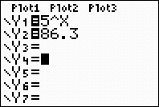
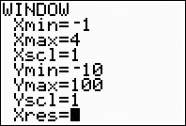
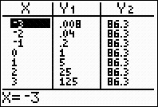
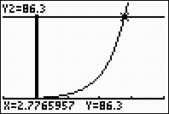
Ex 4.3 , No 30, page – 363 Use a calculator to approximate each logarithm to four decimal places. Make a conjecture about logarithms based on the results of each problem log ₅ 86.3
5²= 25 and 5³ = 125. This means that log ₅ 86.3 must be between 2 and 3.
b) Let x = log ₅ 86.3 . Converting to exponential form, 5^{x} = 86.3. Graph
y1 = 5^{x} and
y2 = 86.3 with Xmin = - 1.
Xmax = 4, Y min = - 10 , and Y max = 100. Use the intersection feature
To find out where y1 = y2
Graphing Calculator
Enter Y Press Window Press 2nd and Table Enter Graph

Slide 7
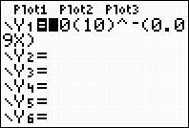
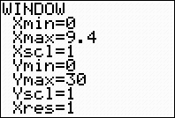
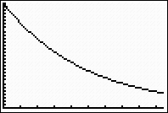
4.3 No.5 4, Pg 365
The elevation of Mount McKinley, the highest mountain in the United States, is 20,320 feet. What is the atmospheric pressure at the top ?
P(a) = 30(10 )^{-0.9a} , Where a= altitude in miles and
P = atmospheric pressure in inches of mercury
X min = 0 Ymax = 9.4
Xmax = 0 Ymin= 30
A= 20,320 feet= 20,320(1/5280) = 3.8485 miles ( 1mile = 5280 feet)
P = 30(10) ^{–(0.09)(3.8485)}
=13.51inch
Check in gr. calculator

Slide 8
Exponential function and Logarithmic function
Exponential function
Logarithmic function
x | f(x) =2 ^{x}
-2 | 1/4
-1 | 1/2
0 | 1
1 | 2
2 | 4
x | g(x) = log ₂ x
1/4 | -2
1/2 | -1
1 | 0
2 | 1
4 | 2

Slide 9
4.4 Properties of Logarithmic Functions (Pg 366)
y = log _{b} x and x = b^{y}
1. Domain : All positive real numbers
2. Range : All real numbers
3. The graphs of y = log _{b} x and x = b^{y}
are symmetric about the line y = x

Slide 10
Properties of Logarithms( pg 366 )
If x, y, and b> 0, then
log_{b}(xy) = log_{b} x + log_{b}y
log _{b} = log _{b} x – log _{b} y
3. log_{b} x^{k} = k log _{b} x
For Example log₂(32)= log₂ (4.8)
= log₂ 4 ₊ log₂ 8
2 + 3 = 5
log₂ 8 = log₂ 16/2 ₌ log₂ 16 - log₂ 2
3 = 4 – 1
3. Log_{b} x^{k} = k log _{b} x
Log₂64 ₌ log₂ (4) ³ ₌ 3 log₂4 = 3 log₂2²
6 = 3. 2 as log₂2 = 1
( property 1 )
( property 2 )
( property 3 )

Slide 11
Compound Interest
The Amount A(t) accumulated (principal plus interest)
in an account bearing interest compounded n times
annually is
A(t) = P (1 + ) ^{nt}
Where P is the principal invested
r is the interest rate
t is the time period, in years

Slide 12
Ex 4.4 ( pg 373) Use properties of logarithms to expand each expression in terms of simpler logarithms. Assume that all variable expressions denote positive numbers
10 a) log_{b}(4b)^{t}
= t log_{b}(4b) ( prop 3 )
= t(log_{b}4 + log_{b}b) ( prop 1)
= t(log_{b}4 + 1) (as log_{b}b = 1)
= t log_{b}4 + t ( Distribute t )
b) log₂ 5(2 ^{x})
=log₂ 5 +log₂ 2 ^{x ( prop 1)}
= log₂ 5 + x log₂ 2 ( prop 3)
= log₂ 5 + x ( as log₂ 2 = 1)
14 a) log₃ (a² – 2)
a⁵
= log ₃ (a² – 2) – log₃ a^{5 ( prop 2)}
= log₃ ( a² – 2) – 5log₃a
b) log a³b^{2/} log (a + b) ^{3/2}
= loga³b² – log (a + b) ^{3/2}
^{( prop 2)}
= log a³ + log b² – log(a + b) ^{3/2 ( prop 1)}
= 3loga + 2logb – 3/2 log (a + b) ( prop 3)

Slide 13
Ex 4.4 ( pg 373 )
Combine into one logarithm and simplify. Assume all
expressions are defined
17. a) log 2x + 2logx – log b) log ( t² – 16) – log (t + 4)
= log 2x + log x² – log x^{1/2} log t² – 16 ^{( prop 2)}
( Prop 3 ) t + 4
= log2x³ – log x ½ ( prop 1) log (t + 4) (t – 4) = log (t – 4)
= log 2x^{3 ( prop 2)} t + 4
x^{1/2}
= log 2x³ ⁻ ^{1/2}
= log 2x ^{5/2}

Slide 14
Evaluate each expression
48. a) log₃(3.27)
= log₃81 = log₃ 3 ⁴ = 4 [ as log₃ 3= 1]
b) log₃3 + log₃27 = log₃3 + log₃ 3 ³
= 1 + 3 = 4
c) log₃3 . log₃27 = log₃ 3 .log₃ 3 ³ = 1.3 = 3
50 a) log₁₀ ( ½ . 80)= log₁₀ 40 = 1.60
b) ½ log₁₀80 = 0.95
c) log₁₀
= log₁₀ 80 ^{1/2}
= ½ log₁₀80 ( Prop 3 )
= 0.95

Slide 15
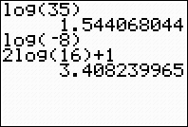
Evaluating Logarithmic Functions Use Log key on a calculator
Let f(x) = log ₁₀ x , Evaluate the following
A) f(35) = log ₁₀ 35 = 1.544
B) f(-8) = , - 8 is not the domain of f , f (-8),
or log ₁₀ (-8) is undefined
C) 2f(16) + 1 = 2 log ₁₀ 16 + 1
= 2(1.204) + 1 = 3.408
In Graphig calculator

Slide 16
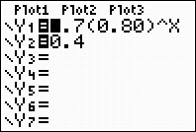
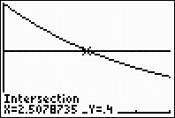
39. ( Pg 374)The concentration of a certain drug injected into the bloodstream decreases by 20% each hour as the drug is eleminated from the body. The initial dose creates a concentration of 0.7 milligrams per millileter. a) Write a function for the concentration of the drug as a function of time b) The minimum effective concentration of the drug is 0.4 milligrams per milliliter. When should the second dose be administered c) Verify your answer with a graph
Solution:
Note that if the concentration decreases by 20%, then there is 80% left in
the bloodstream. Therefore, the concentration is C(t) = 0.7(0.80)^{t}
Enter Y
b) Let C(t) = 0.4
0.4 = 0.7(0.80)^{t}
4/7 = 0.80t
Log₁₀ 4/7 = log₁₀0.80^{t}
Log₁₀ 4/7 =t log₁₀0.80
Log ₁₀ 4/7 = t
Log ₁₀ 0.80
2.5 = t
The second dose should be administered after 2.5 hours.
c) To check graphically, find the intersection of the line y = 0.4 and C(t) .
Here we graph using Xmin = 0 , Xmax = 5, Ymin = 0 and Ymax = 0.7
Graph

